Slide 1
Literature Review of Separation, Collision Avoidance, and ATC Mechanics
Christopher Lum PhD lum@uw.edu
Al Creigh, Undergraduate Student Al.Creigh@yahoo.com
September 27, 2013

Slide 2
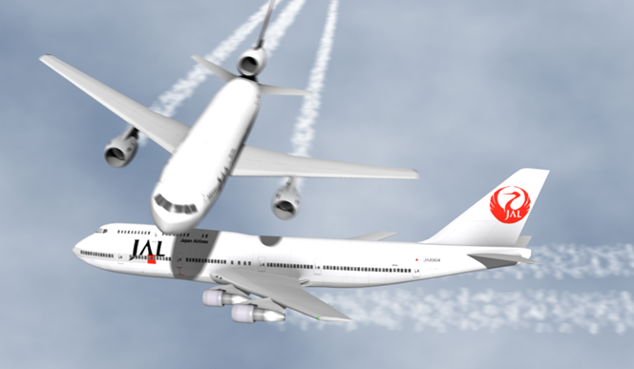
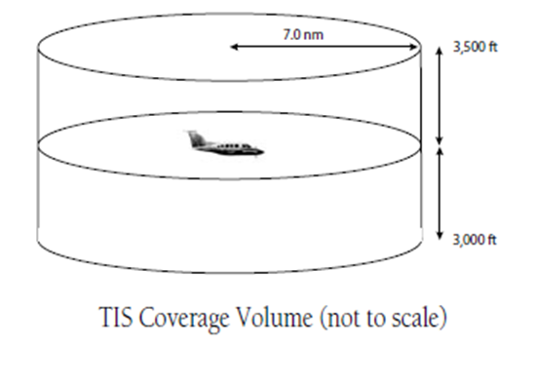
Transition
Most collision avoidance was in relatively closer proximity
Increased scope to include separation management after meeting with FAA flight controller (Matt McCully 08/23)
Noticed separation techniques are highly successful
Began looking into literature on ATF mechanics and similar systems involved in separation

Slide 3
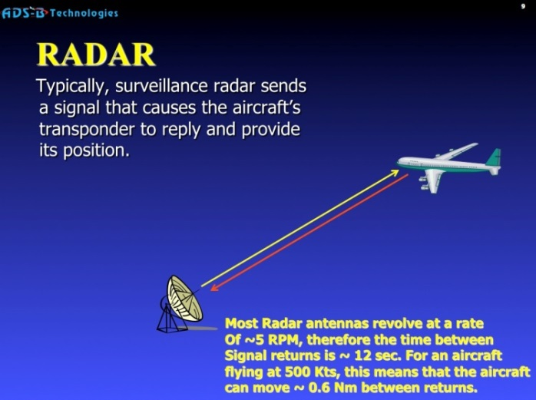
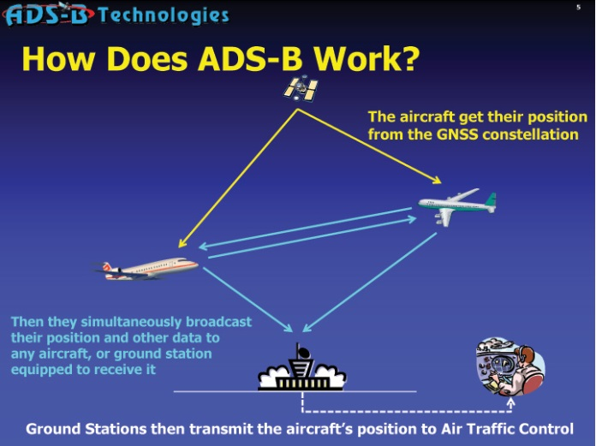
Future Requirements
ADS-B required for aircraft flying with mode C transponders in US airspace by 1/1/2020
FAA flight controller techniques
Understand requirements to satisfy or mimic possible future expectations

Slide 4
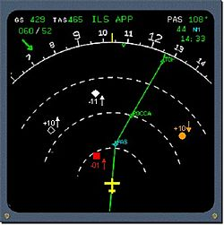
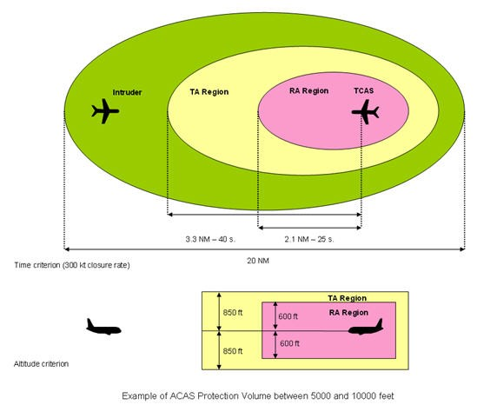
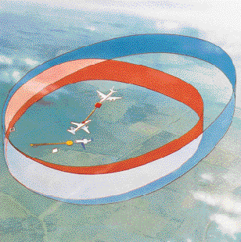
Other systems
Garmin 530
Traffic Collision Avoidance System
Airborne Collision Avoidance Systems

